Slide 1


Data Analysis in Social Media & content creation

Slide 2


Today's agenda
Project recap
Problem
The Analytics team
Process
Insights
Summary

Slide 3

Social Buzz is a fast-growing technology unicorn that needs to adapt quickly to its global scale.
Accenture has begun a 3 month POC focusing on these tasks:
An audit of Social Buzz's big data practice.
Recommendations for a successful IPO
Analysis to find Social Buzz's top 5 most popular categories of content.
Project Recap

Slide 4


Problem
Over 100000 posts per day
23,500,000 pieces of content per year!

Slide 5



Andrew Fleming (Chief Technical Architect)
The Analytics team
Marcus Rompton (Senior Principle)
Myself
Data Analyst

Slide 6
Process
1
2
3
4
5

Slide 7
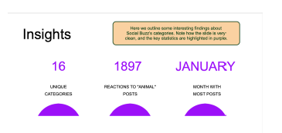
Insights

Slide 8
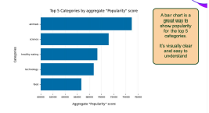

Slide 9
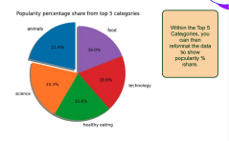

Slide 10

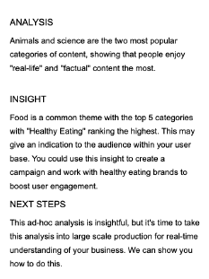

Summary

Slide 11

Thank you!
ANY QUESTIONS?

